Slide 1
How I saved the World with Dailyclean, an open sourced tool developped in Quarkus
Guillaume THOMAS
Notes:
Hi eveyone ! Welcome to this talk.
My name is Guillaume and today, I would like to tell you a wonderful tail about GraalVM and Quarkus.

Slide 2
Table of contents
Why?
What?
How?
Why GraalVM & Quarkus?
Code!!!
Notes:
This is the map of our journey

Slide 3
Why?
What?
How?
Why GraalVM / Quarkus?
Code!!!
Notes:
So relax, take a sit and a warm coffee. Let's Go !

Slide 4
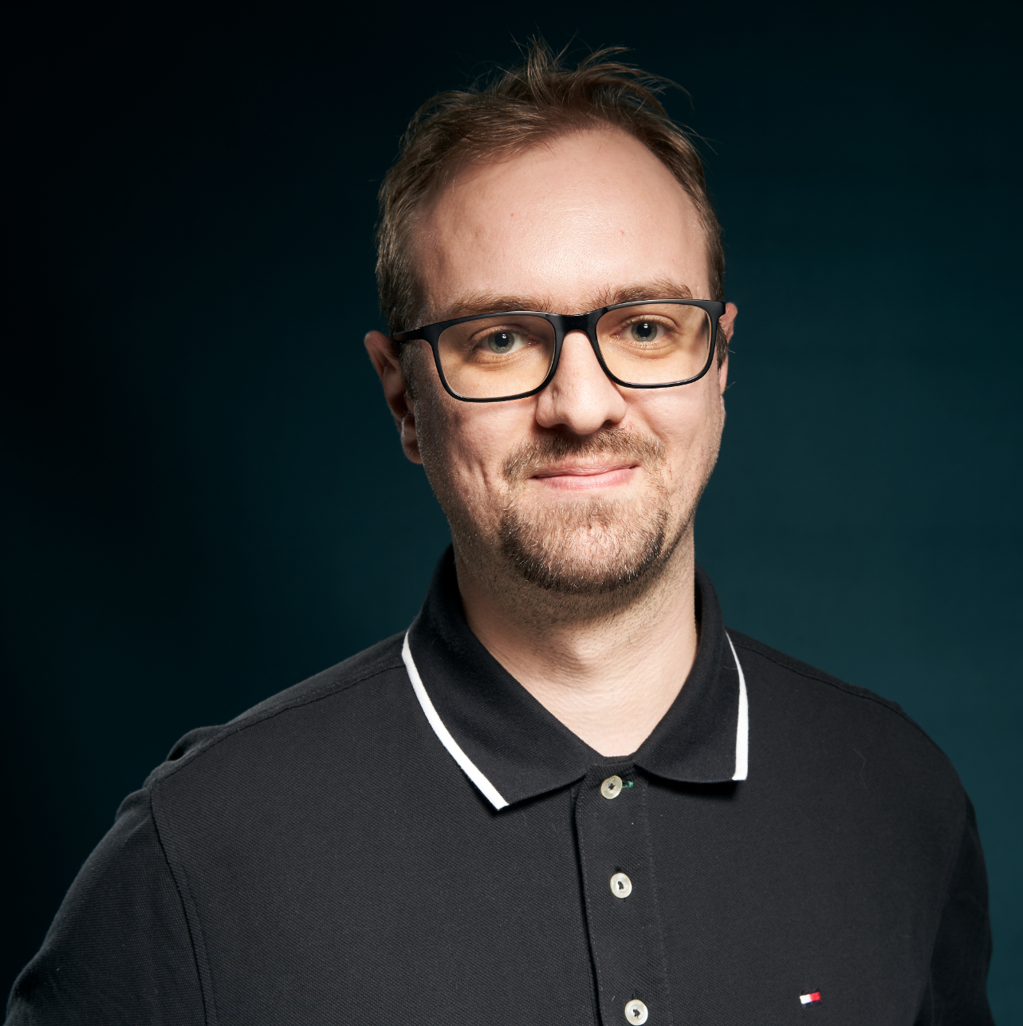
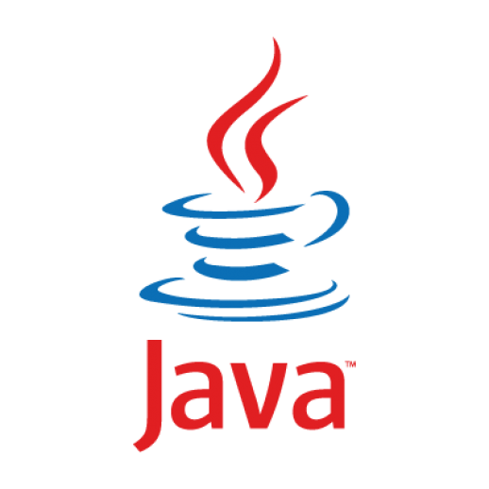
Guillaume THOMAS
ML Engineer
BigData & New Technologies @AXAFR
Notes:
Our story begins in AXA France.
First, let me introduce myself. I'm currently working as an ML developer in a team called : BigData and new technology.
Our mission is to help Data scientists to make their AI applications working in production efficiently.
Often, these types of applications execute a lot of processes. So, we design our solutions as microservices.

Slide 5
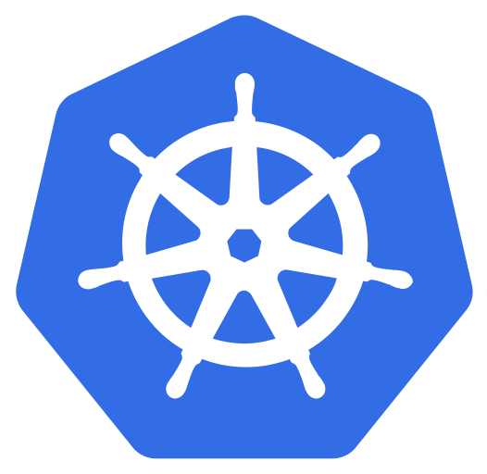
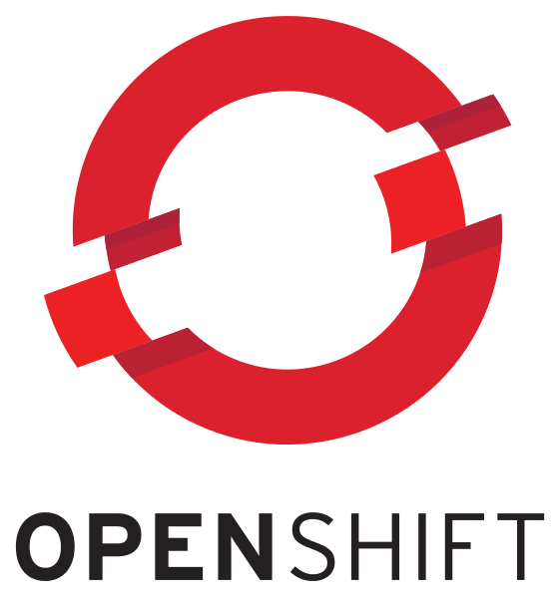
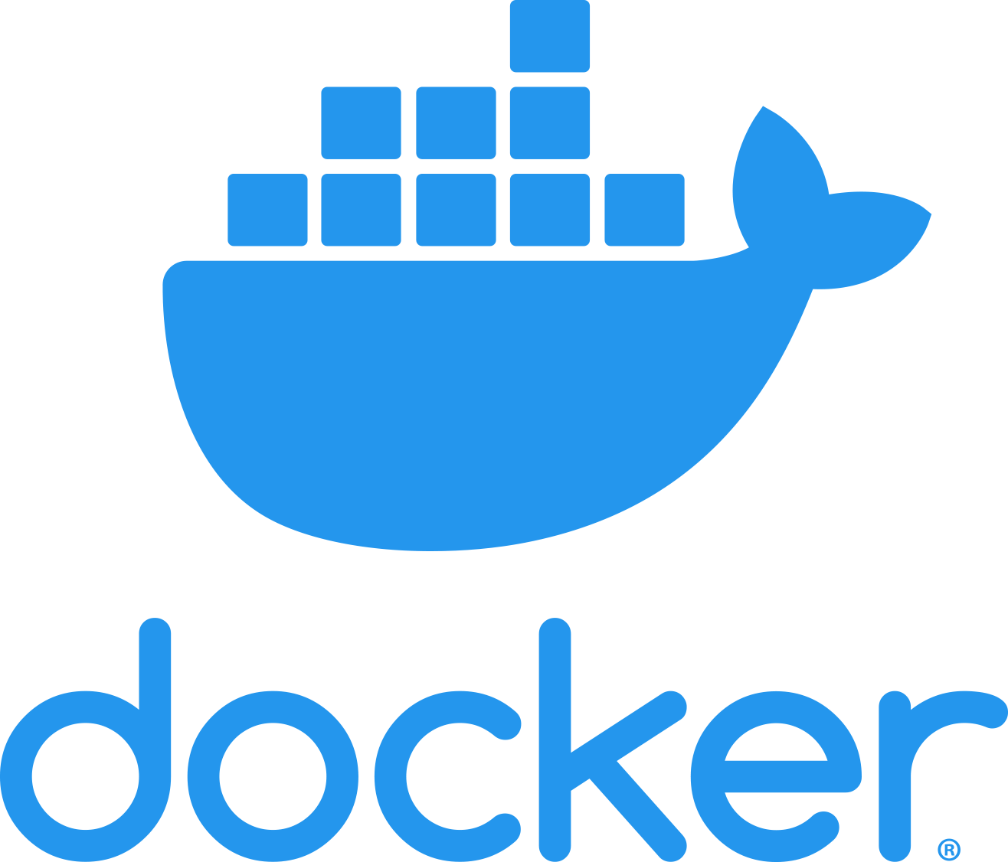
Notes:
As a platform, we’ve chosen OpenPaaS (which is an OpenShift).
OpenShift relies on Kubernetes and Docker (containers).
In this talk, I will not doing an exhaustive presentation of these guys. But I will summarize some concepts in order to explain to you the context of our story.
In our case, each application on each environment is represented by an object called a Namespace.
A day, a new OCR application was born.
This one allows us to read information from french driver licenses.
But this kind of application can be very complex with a lot of heavy services.

Slide 6
$
XX,XXX € / month
Notes:
Finally, we had/encountered FinOps issues. And this made us very sad …
The infrastructure was too expensive and we were looking for solutions to decrease our costs.

Slide 7
$
X,XXX € / month
÷ 10
$
Notes:
And today we are proud to announce that we have divided our costs by … 10 !!! And that make us very happy !
To achieve this goal, One of our solutions we built up was the dailycleanAPI.
A wonderful application which save our money and help to save our planet.

Slide 8
Why?
What?
How?
Why GraalVM & Quarkus?
Code!!!

Slide 9

24 hours per day | 7 days per week | 12 months per year
12 hours per day | 60 hours per week | 240 hours per months
Demonstration By Julien Hatzig

Slide 10
12 hours per day | 4,5 days per week | 7 months per year
67 %
Demonstration By Julien Hatzig

Slide 11

Demonstration By Julien Hatzig

Slide 12
Demonstration
Notes:
This solution has been designed and developed by ops & developers. Let me take a minute to salute them : Thomas LEMARCHAND, Pierre-J=Henry Gache and Guillaume CHERVET
This tool allows developers, Ops and Product Owners to manage their namespaces.
Obviously, Production is NOT managed
- They can start or stop an application on the fly
- Thay can get the state of their application (stopped, starting, running)
- They can give a start hour and an end hour to automatically start and stop the application each day
They can get some other information
Unfortunately, this kind of tool does not exist out of the box with Openshift. So we had to create it.

Slide 13
Why?
What?
How?
Why GraalVM & Quarkus?
Code!!!

Slide 14
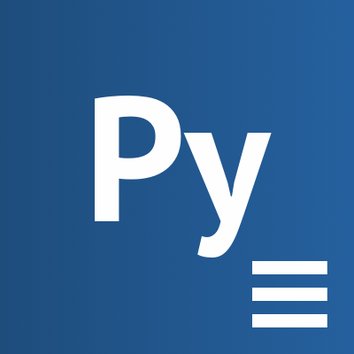
creates
executes
CronJob
Job
schedule = 0 9 * * *
Notes:
In openShift, a container is called a pod.
And in our case, Each pod is an instance of a microservice.
In OpenShift, pods are replicated.
To extinct a pod, you can set its replica number to 0
To start a pod, you can set its replica number to 1, at least.
To do so, our ops developed a script which can set this number of replicas for all the pods of a namespace.
To execute this script, Kubernetes gives us an object called a Job.
To plan an execution of a job each day, Kubernetes gives us an object called a CronJob.
In other words, A CronJob create and execute a Job. The Job execute a script.
We can set a TTL to this job. Then, when the job finishes its execution, it deletes itself.

Slide 15
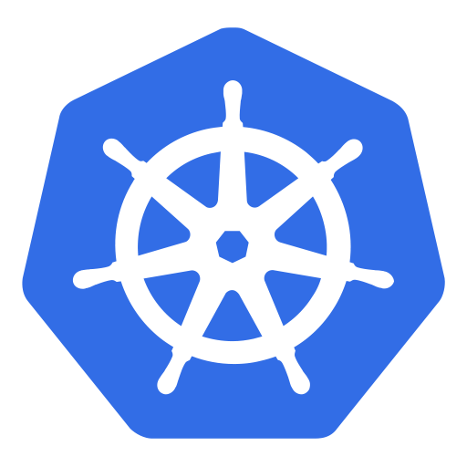


KUBERNETES API
CronJob start
Job start
Replicas = 1
DailycleanAPI
Replicas = 0
Job stop
CronJob stop
Job start
Replicas = 1
DailycleanFront
Job stop
Replicas = 0
Notes:
To summarize:
When we want to start pods from a namespace, we create a Job to start them.
When we want to stop pods from a namespace, we create a Job to stop them.
When we want to update start/stop scheduling, we delete and create a new CronJob.
To create or delete Jobs and CronJobs, we can use the Kubernetes API
Finally, we had to develop a front and an API which calls the Kubernetes API to manage our pods.

Slide 16
Why?
What?
How?
Why GraalVM & Quarkus?
Code!!!

Slide 17
Easy to develop
Fast
Less memory footprint as possible
Notes:
First, Let me remember you our architecture. To ease the governance and the security of our tool, we chose that each namespace will have its own instance of dailyclean tool.
As such, we had to find a language & a FWK who was :
Easy to develop
Fast
And first and foremost with the less memory footprint as possible
First we thought about GO. But when we asked who knew how to code in GO … reactions were … like this …

Slide 19

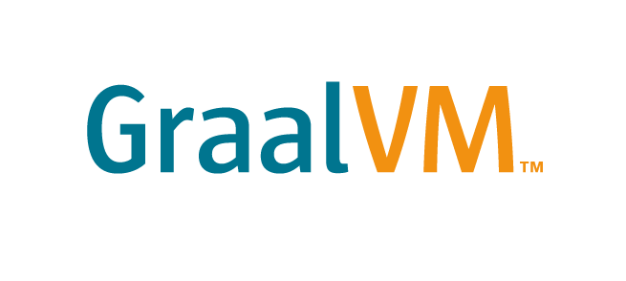
Notes:
And finally, Because there were Java developers in our team, we suggested to explore two new technologies to us.
And they are GraalVM & Quarkus.
Finally !
First what is graaalVM ?
Wikipedia definition ! Heeem !
GraalVM is a Java VM and JDK based on HotSpot/OpenJDK, implemented in Java. It supports additional programming languages and execution modes, like ahead-of-time compilation of Java applications for fast startup and low memory footprint.

Slide 20
Ahead-of-time compilation
Fast startup & low memory footprint
.JAR
=> .EXE
Notes:
… and execution modes, like ahead-of-time compilation of Java applications for fast startup and low memory footprint.
And THAT is very interesting to us !
In other words, we can say that your artifacts turn from this To this
And in other words, we do not need for a JVM running in our containers anymore

Slide 21
Notes:
Now, what is Quarkus ?
Wikipedia definition again
Quarkus is a Kubernetes Native Java framework tailored for OpenJDK HotSpot and GraalVM, crafted from best-of-breed Java libraries and standards.
The goal of Quarkus is to make Java a leading platform in Kubernetes and serverless environments while offering developers a unified reactive and imperative programming model to optimally address a wider range of distributed application architectures.
To summarize, it’s more or less like a Spring boot compatible with GraalVM ahead-of-time compilation

Slide 22
And now… a little experiment!

Slide 24
Highly supported by RedHat (who develop OpenShift)
Dailyclean is NOT a Production project
New opportunities as Serverless applications

Slide 25
Why?
What?
How?
Why GraalVM & Quarkus?
Code!!!

Slide 26
Dailyclean is open sourced
https://github.com/AxaGuilDEv/dailyclean

Slide 27
Questions ?
guillaume.thomas@axa.fr
@gthomasIT

Slide 28
THANK YOU!!!

